Slide 1
New Features of latest Android：Android 12
Anqi Zhao NEU-Seattle 2021Fall CS5520 zhao.anq@northeastern.edu

Slide 2
Take away
What new features does Android 12 release?
What existing features does Android 12 update?
What points should Android developers notice?
Take Away

Slide 3
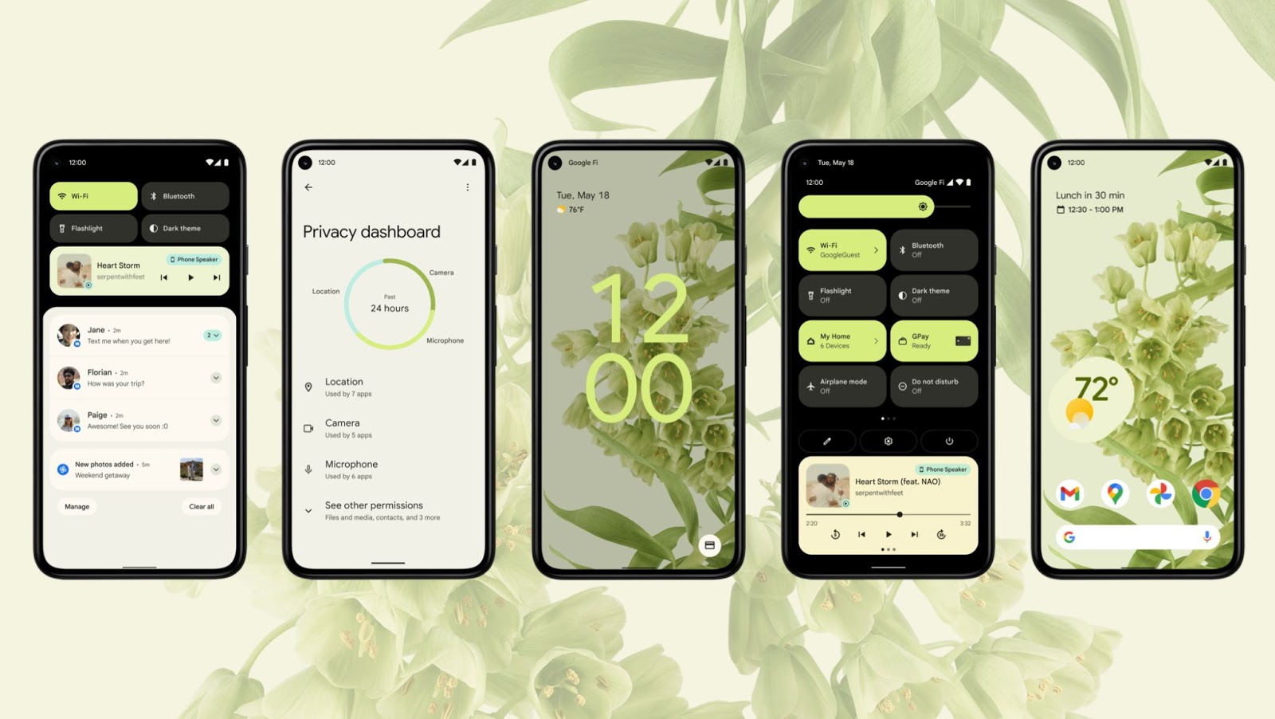
Material You！
Extract colors from the background image
Notes:
Google calls it color extraction, where you can pick a wallpaper and the system will automatically apply the dominant, complimentary and best looking colors from it to the rest of the UI, including the notification shade, the lock screen, and volume controls.

Slide 4
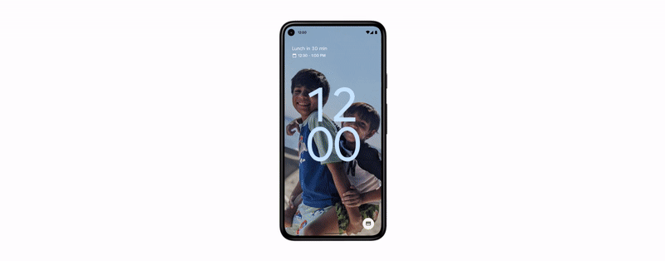
Material You！
Generate almost all icons and tools based on these colors
Highly personalized
Unified and congruous
Third-party apps ☹

Slide 5
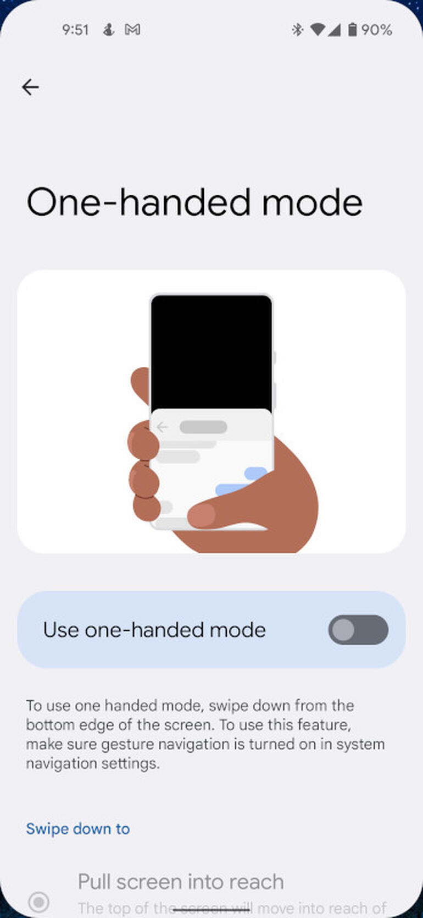
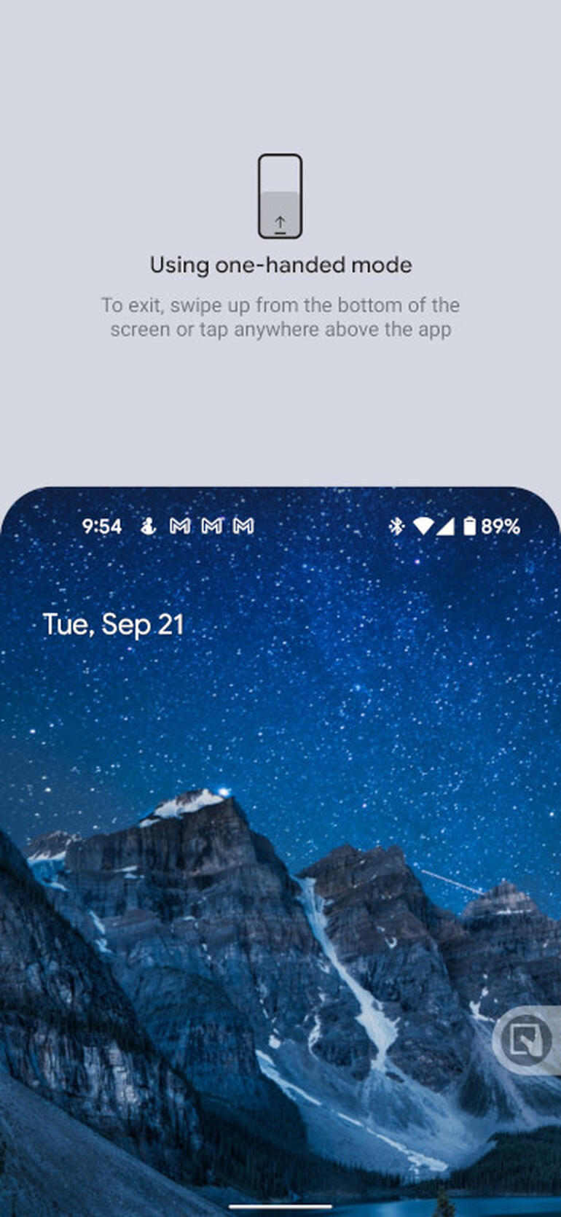
One Hand Mode

Slide 6
Personalized Floating Window
How big you want your floating windows are? You decide it!
Even through half of the floating window out of the screen
Might be more promising on folding screen phones

Slide 7
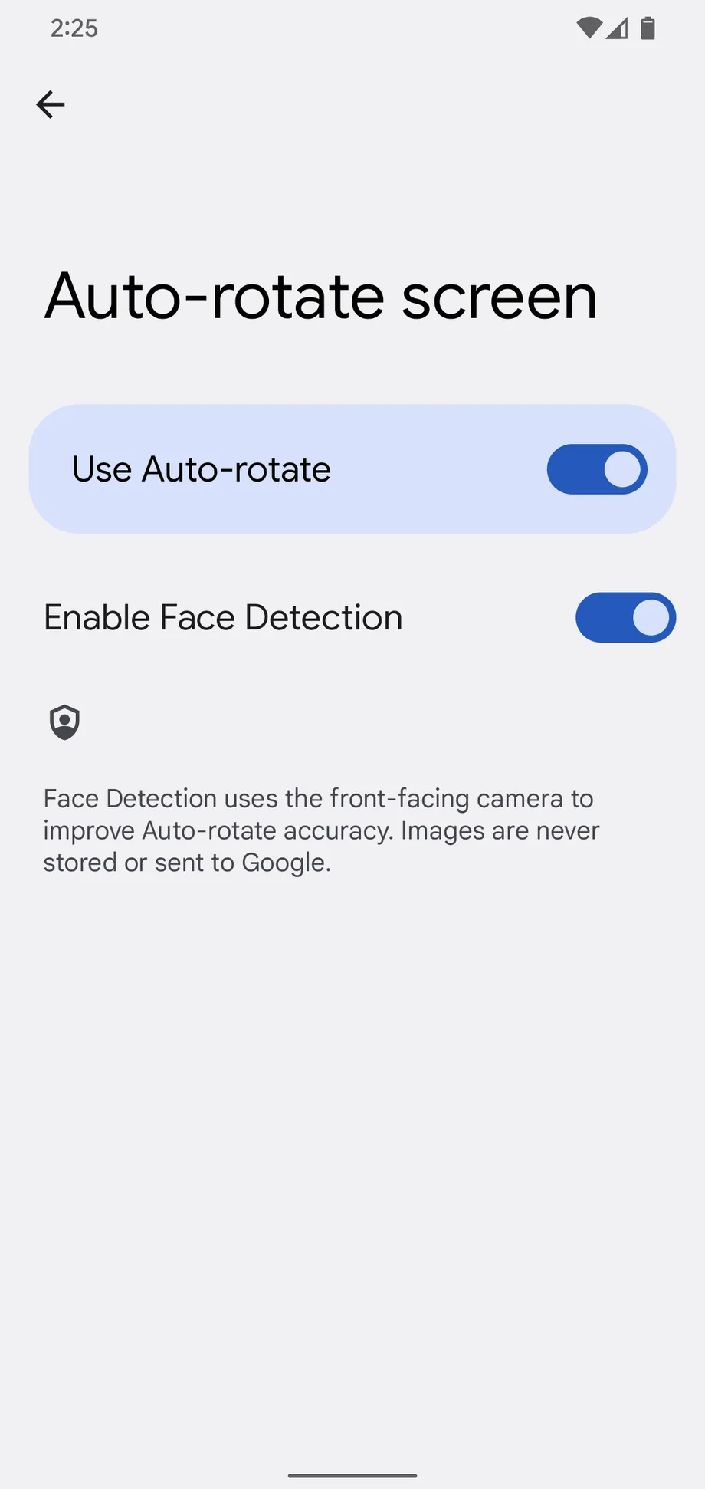
Smart Rotation！
Find out the relationships between your face and the screen
Won’t change if you tilt your head (lay down) & rotate screen simultaneously

Slide 8
Sharing Straight Forward
Drag and through images/links directly to the person you want to share with
No need to store/download/copy

Slide 9
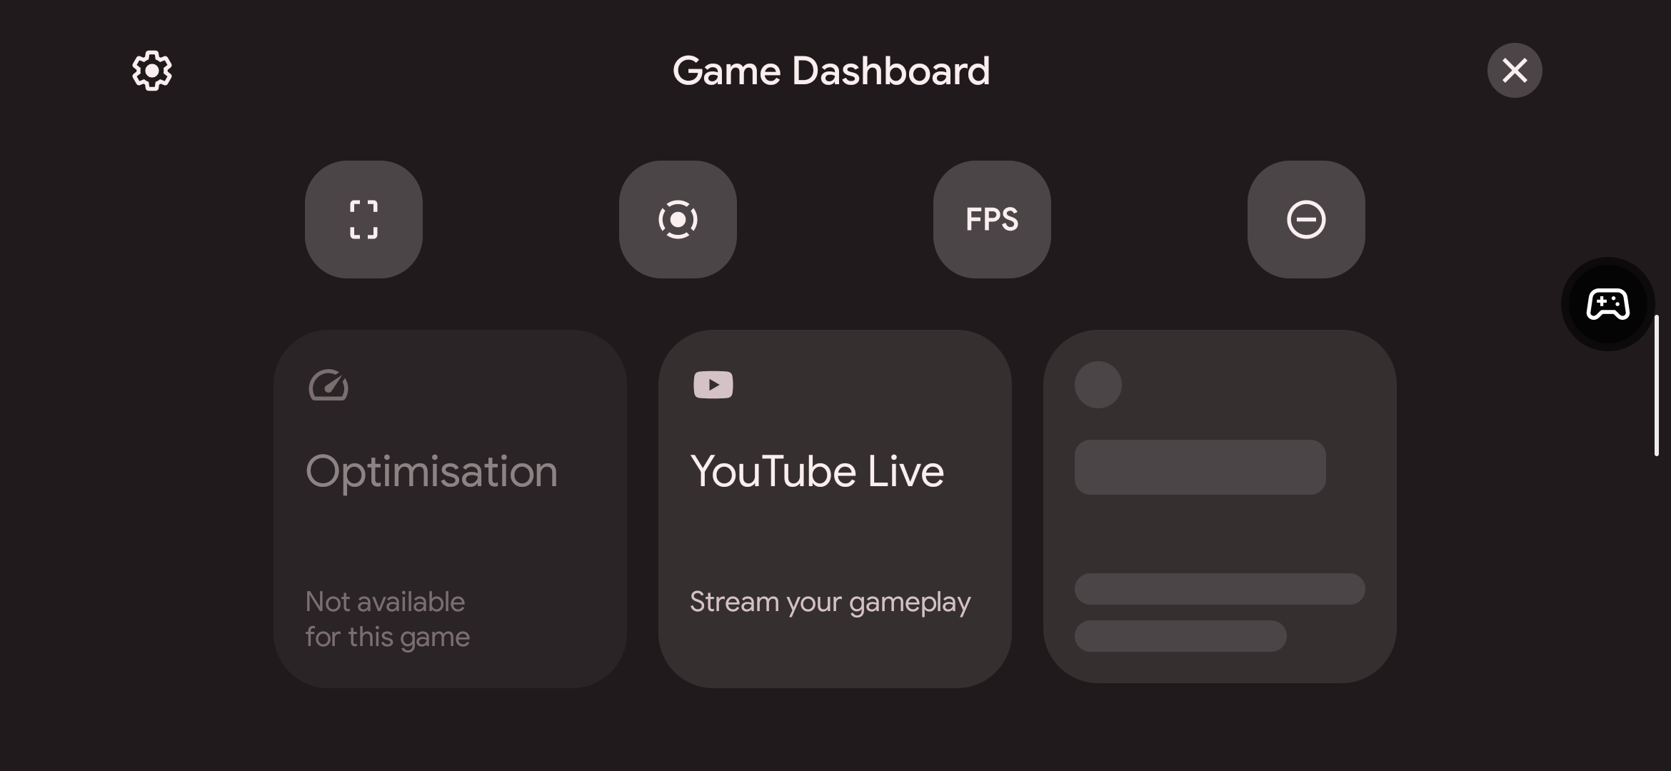
Game Features
Floating dashboard for settings, tools, stream to third-parties live
Haptic API with better vibration feedback

Slide 10
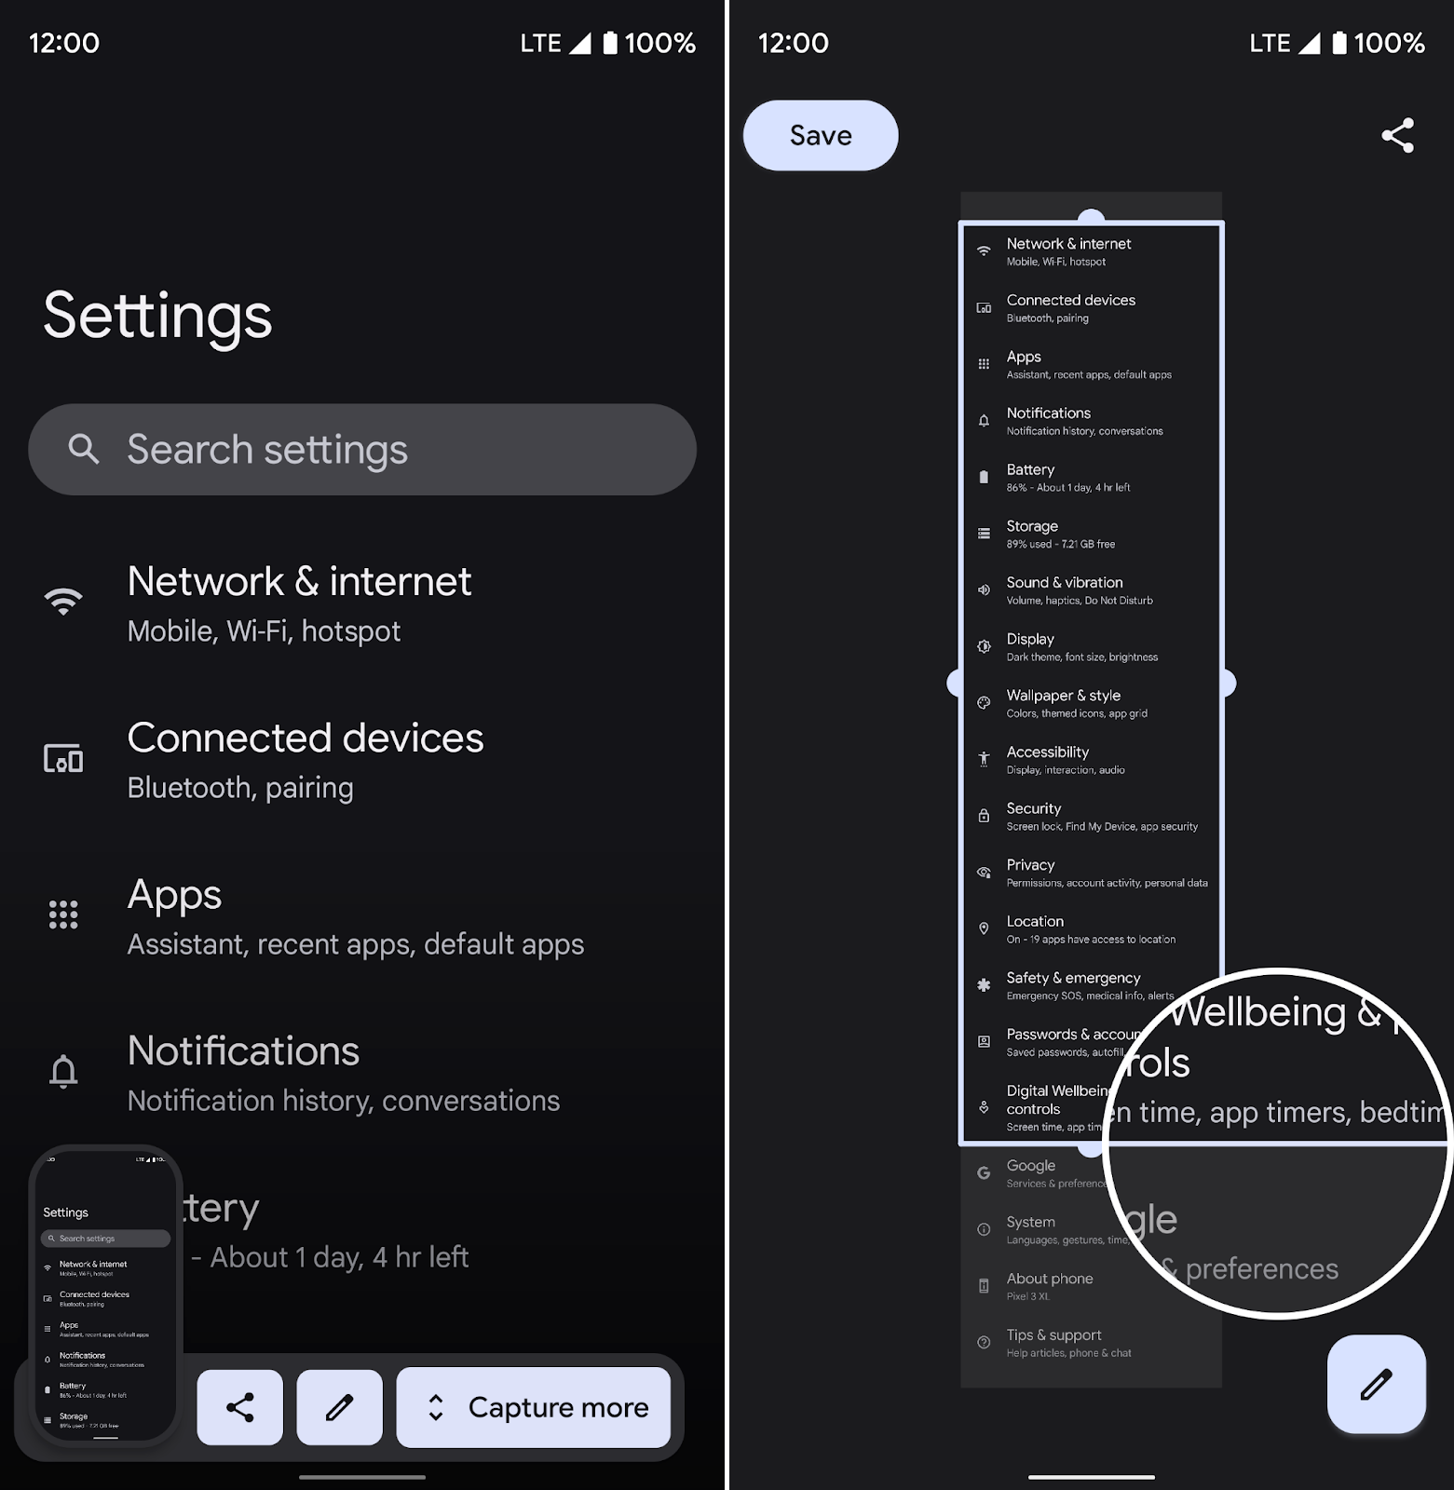
Scrolling Screenshot
Finally!
“fake” scrolling?

Slide 11
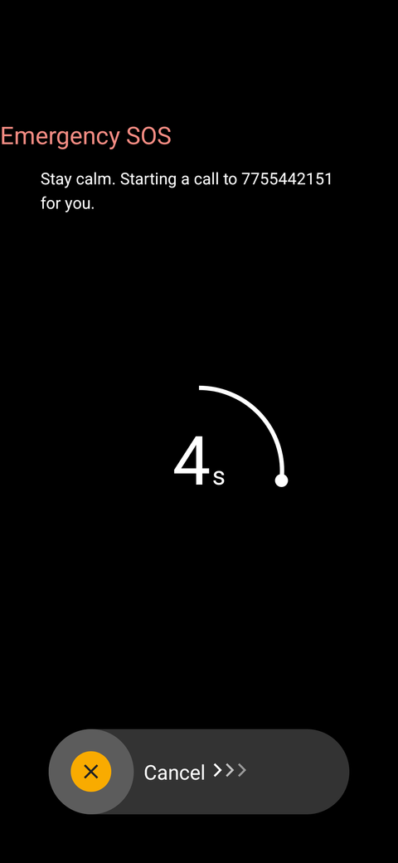
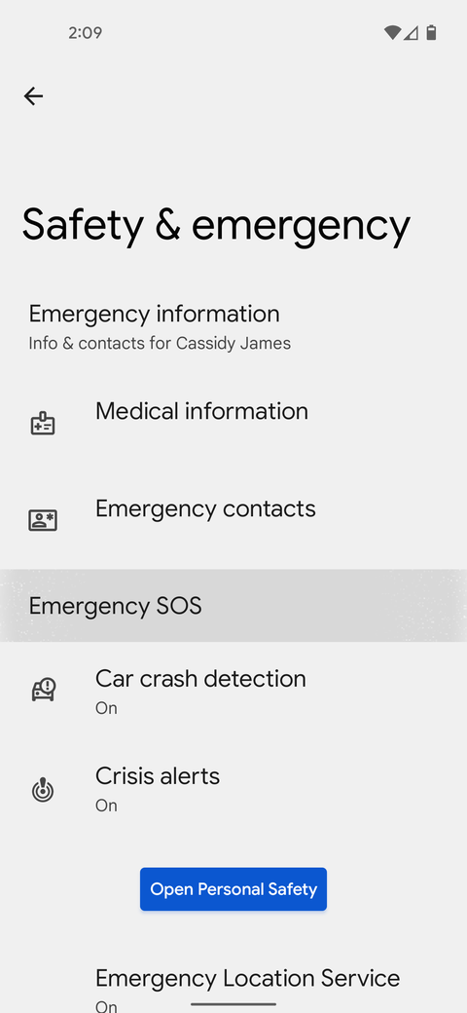
Emergency SOS
Tap 5 times on your power key
Link with medical information & emergency contacts

Slide 12
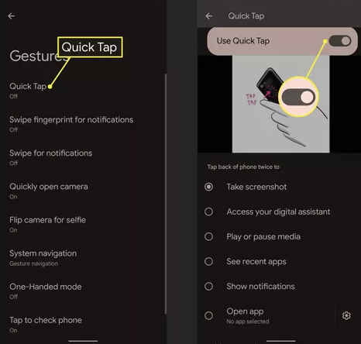
Quick Tabs
Assign a tap on the back of your phone to do things
Works even on phones without a fingerprint scanner
(detecting through sensers of the phone, not the scanner

Slide 13
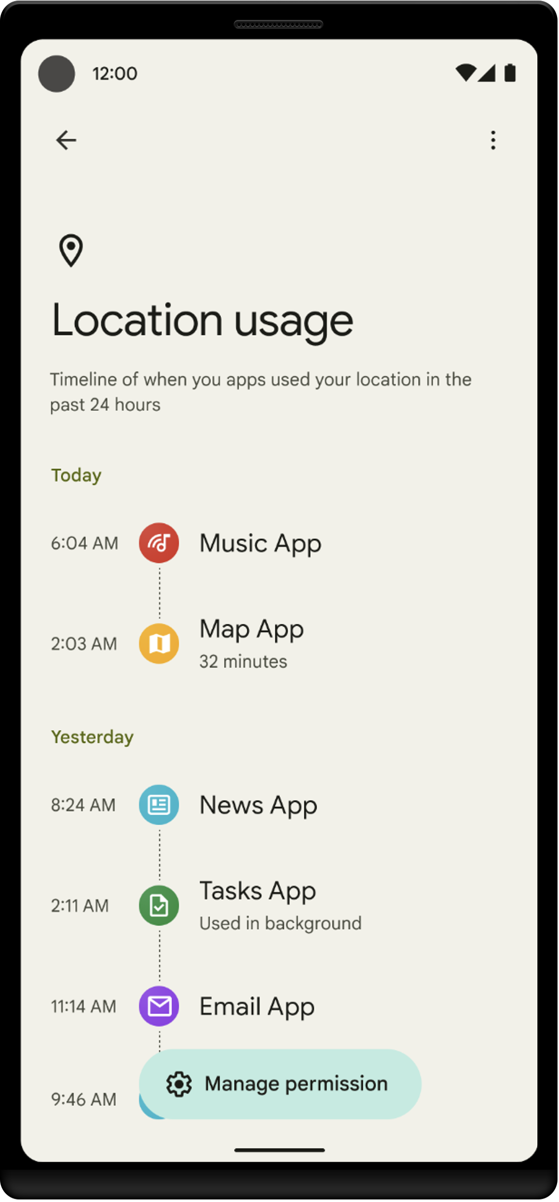
Privacy
See all the histories of which app were using which senser on where and when

Slide 14
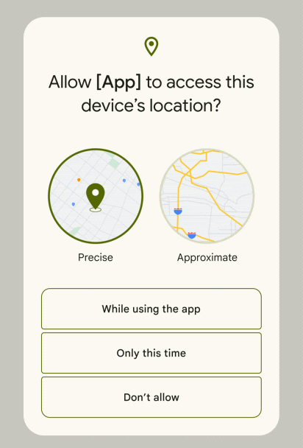
Privacy
Control location sharing mode
Precise or Approximate?

Slide 15
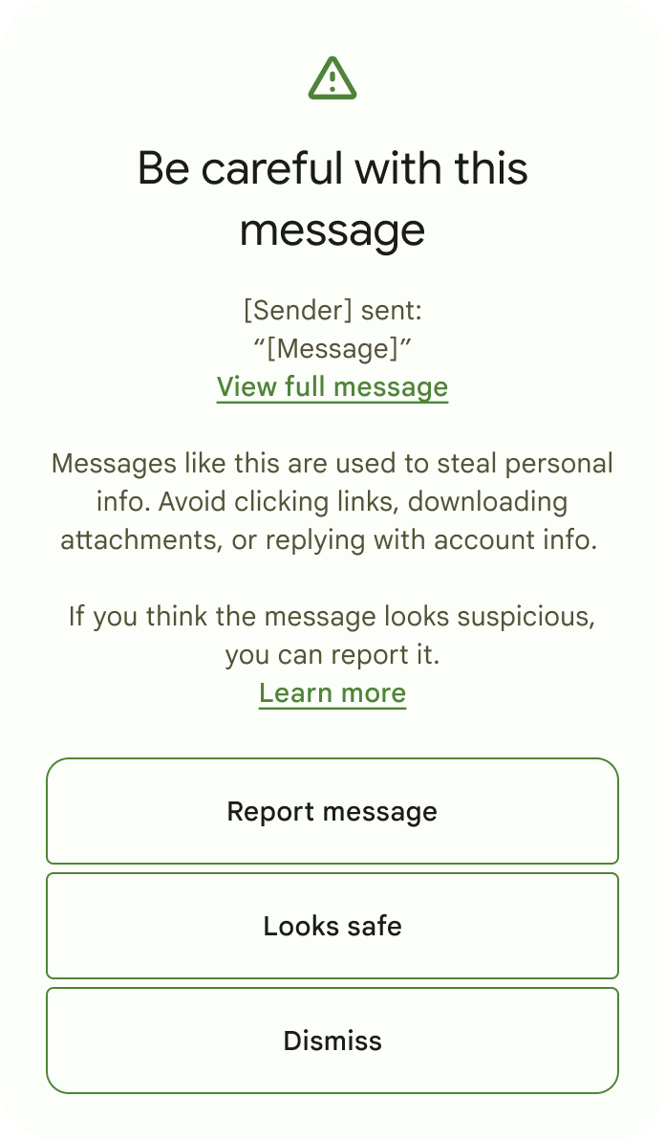
Privacy
Warning suspicious requests
Icon in the status bar when microphone & camera are using by apps
Turn microphone & camera off in one step

Slide 16

CPU 22%
reduced the CPU time needed for core system services by 22%! so devices will be faster and more responsive

Slide 17
Battery
Improved power efficiency by 15%
Shown usage for the past 24 hours
Optimize battery life and send the over consuming apps to battery jail

Slide 18
Android 12 Summary
Personalization & flexibility
Privacy & transparency
USER EXPERIENCE!

